Slide 1
UCPath Overview PPS Data Warehouse to UCPath Data Warehouse
UC Davis Application Development SIG
September 12, 2017

Slide 2

Topics
Architecture and Resources
Overview
Position – Job – Person
Employee ID, Home Department
Social Security Number
Timeline
Updates
Technical Workgroup resources

Slide 3
Risks: Why We Need UCPath
11 different payroll technologies system-wide.
Existing systems require manual calculations and processes, which can result in avoidable errors and rework.
Existing technologies are insufficient for UC’s complex employee population and changing business needs.
Existing systems are nearly 40 years old!
Notes:
What are the risks if we do not implement UCPath?
There are 11 existing payroll systems across the UC system, which are disconnected, outdated and expensive to maintain because they vary widely from one location to the next.
The existing systems require manual calculations and processes that can result in avoidable errors and rework.
The existing systems are nearly 40-years-old and at risk of breaking down in the future. Furthermore, the old technology is insufficient for UC's complex employee population and changing business needs.
(The presenter could add an aside about the systems being as old as IBM’s first computer, if appropriate for the audience.)

Slide 4

Changing the Way We Work
Business transformation
Efficiency
Productivity
Shared services
Notes:
As you saw in the video, UCPath is one of the largest business transformation projects in the country.
We really see this an opportunity to look at our business processes with an eye on efficiency and productivity.
And from system level, we are looking at what types of activities can be done more efficiently in a shared services model.
We are changing the way we work through:
Business transformation
Efficiency
Productivity
Shared services approach

Slide 5
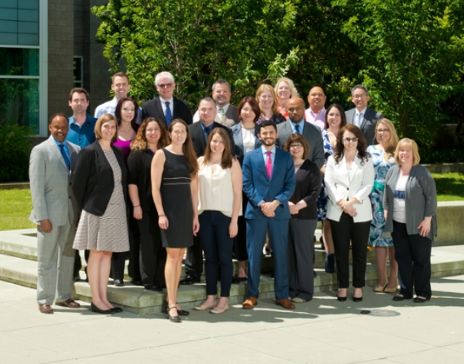
Paving the Way for Future Growth
Utilizing technology to streamline transactions
Providing system-wide HR information and analytics
Freeing up time to let units focus on the core mission
Notes:
BY CHANGING THE WAY WE WORK, we are paving the way for growth.
Better utilizing technology to streamline transactions
Providing systemwide HR information and analytics – (This is something that is lacking with our current technologies. And it will help HR as a central office at UC Davis to focus on strategic planning and oversight.)
Freeing up time and letting units focus on the core mission of the university.

Slide 6
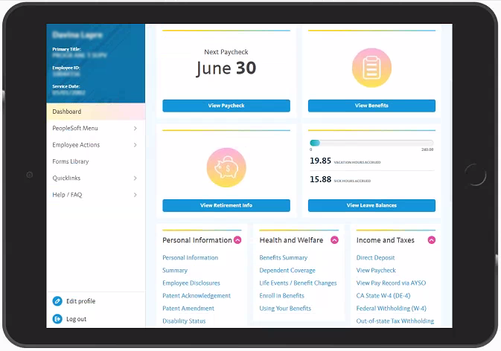
Putting More Options in Employees’ Hands
Employee Self-Service:
A new way to manage your payroll, benefits and employee information.
Notes:
UCPath puts more options in employees’ hands.
This is a screen capture from the new employee self-service portal. Most of it is probably too small to read, but those four windows at the top are:
View Paycheck
View Benefits
View Retirement Info
View Leave Balances
These are the most frequently accessed types of information, followed by information and guides to a variety of other topics, like how to add a dependent or income and tax information.

Slide 7
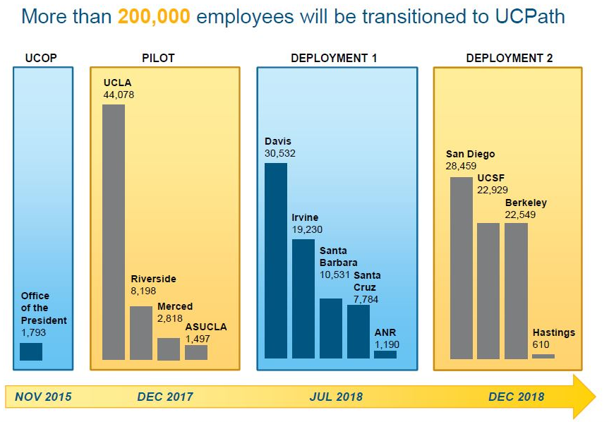
UCPath Implementation Sequence

Slide 8
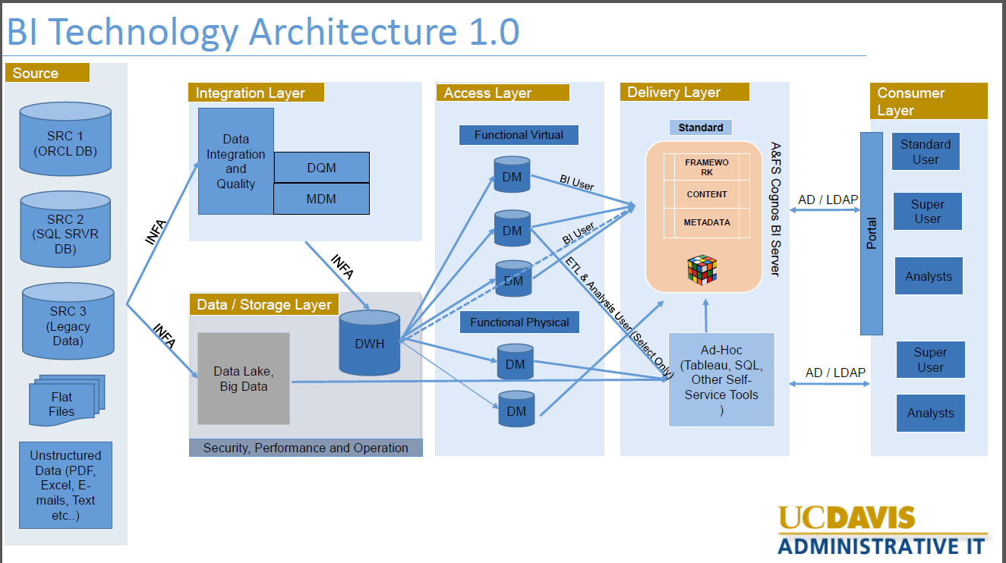

Slide 9
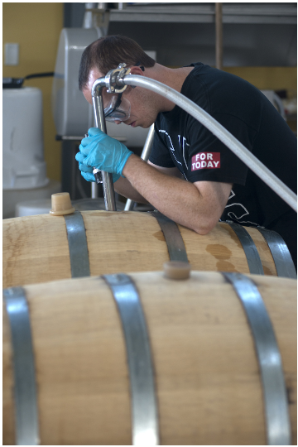
Tier1 and Tier N
Tier 1 – Provides or receives data from UCPath
Tier N – Datamart data a day later after Central DDODS and local data transformations
Tier 1 first test end of June
High level meetings with Tier 1 partners
Technical and Project work
Regroup/Update mid-May
Tier N
Working on ODS mappings to PPS values
Mapping Parking data first
Generate timeline for rest of mappings

Slide 10
There are 3 mechanisms for analyzing the data.
Data Analysis
Data Marts
PS Queries
Cognos Reports

Slide 11
Summary of Reports by Module
Pilot Day 1 Reports
Module | Number of Reports | UCD Installed Cognos Reports
Absence Management | 4 | 1
Benefits | 5 | 0
Payroll | 11 | 1
Compensation | 16 | 10
GL Integration | 23 | 15
Workforce Administration | 44 | 4
Total Reports | 103 | 53
Out of 53 installed reports, 14 are PS Query Cognos reports
Next batch of reports code – Not before November 2017
Notes:
Out of 53 installed reports, 14 are PS Query Cognos reports
Next batch of reports code –November 2017

Slide 12

PPS: Person-Appointment-Distribution UCPath: Position-Job-Person
Person Data Moving

Slide 13
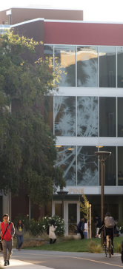
Person fields fall in to three groups:
Field translates to UCPath (ex: name)
Field can be derived (ex: Academic Senate indicator)
Field has an alternative at the position/job level but interested in how this is currently being used (ex: CBUC)

Slide 14

Employee ID Changing
Currently 9 digit character string
New Employee ID will be 8 characters long
The new field will allow up to 11 characters
Future discussion

Slide 15
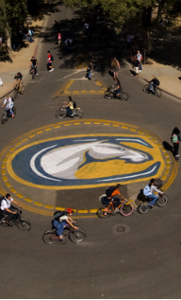
Home Department Number: UC Davis Health
Currently Using PeopleSoft
Using 8 Digits Department Numbers
PS to PPS Feed Mapping 8 Digit Codes to 6 Digit Codes
Discussing Impact on medical schools

Slide 16
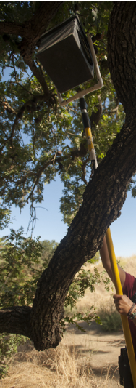
Social Security Number
SSN is not in the UCPath Data Warehouse

Slide 17
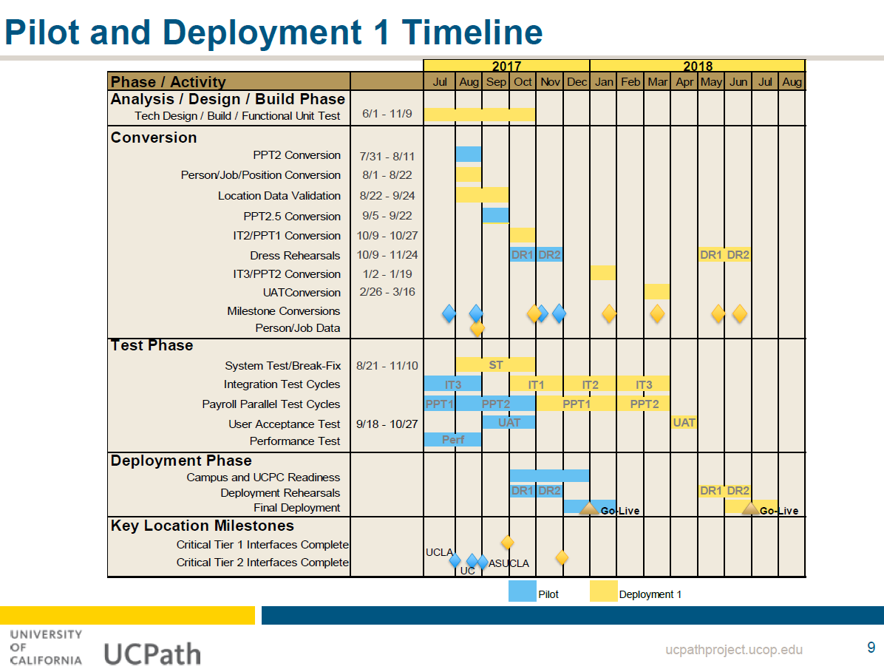

Slide 18
Updates
Full dataset delay
Number of Data Marts
Access to Other Units’ Data
PPS to PS Data Mapped

Slide 19
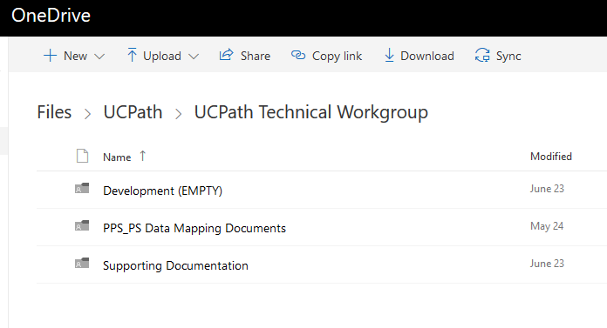
Technical Workgroup Resources
https://ucdavis365-my.sharepoint.com/personal/cffsmith_ucdavis_edu/_layouts/15/onedrive.aspx?e=5%3A714372f8c3544a979b01bfbc7b8e5c28&id=%2Fpersonal%2Fcffsmith%5Fucdavis%5Fedu%2FDocuments%2FUCPath%2FUCPath%20Technical%20Workgroup&FolderCTID=0x0120007EA3A131B0CB4748A997E410FC2B3F43

Slide 20
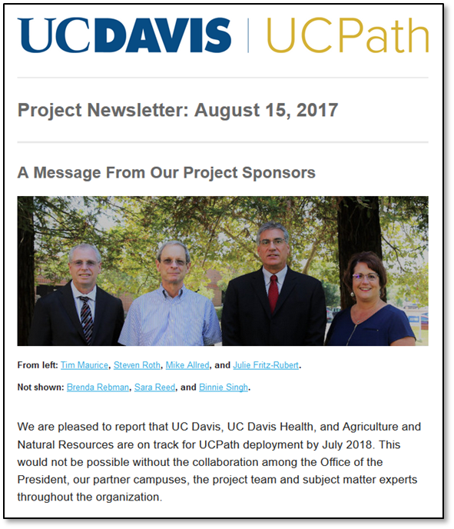
Preparing for UCPath
Update department data prior to UCPath deployment
Follow UCPath news and updates
Participate in training
Spread the word!
Notes:
This should be a call to action stating what kind of participation/involvement we need from HR.

Slide 21
Information and Resources
Email: ucpath@ucdavis.edu
Website: ucpath.ucdavis.edu
Training schedule and resources to be posted on the UCPath website approximately four months before go-live
Sign up for the UCPath newsletter at ucpath.ucdavis.edu

Slide 22
Questions? Contact the UCPath Project Team at ucpath@ucdavis.edu

